Slide 1
SNAP Training & Employment Program (STEP) Reducing barriers to education, training and employment Joan Jagodnik, STEP Grant Coordinator 503-594-3525 joan.Jagodnik@Clackamas.edu
Marc Goldberg, Interim Title II Director

Slide 2
What is STEP and SNAP 50/50?
STEP = SNAP Training and Employment Program (a statewide consortium of community colleges led by Portland Community College)
SNAP = Supplemental Nutrition Assistance Program
SNAP 50/50 = A federal and state partnership to provide services and resources to students who receive SNAP. This partnership allows us to receive 50% reimbursement for our time and resources when working with students in this program

Slide 3
How does STEP support students?
CASE MANAGEMENT:
STEP Case Managers….
Provide success coaching and academic & career support
Help with navigating & coordinating with other resources
Help students find a job or grow skills for a better job
FINANCIAL SUPPORTS:
STEP can assist with…
Paying for books and supplies
Transportation costs, such as gas cards or bus passes
Other support as needed and as funds are available

Slide 4
Where does our funding come from?
Reimbursement for Time and Effort: The time that identified employees spend supporting students, doing program planning, talking with students about the program, etc. is reimbursed at a rate of 50%. For example, if Jennifer and I spend an hour discussing STEP, 50% of both of our salaries for that hour is reimbursed to the program.
Reimbursement for Financial Supports: For example, if a students needs books for their classes and we spend $200 on those books, $100 is reimbursed back to the program.
Grant funds from various sources including Future Ready Oregon, Career Pathways, Oregon President’s Council, and more.
This money goes back into the STEP budget to support students and the program.

Slide 5
What are the eligibility requirements?
Receive SNAP (but not TANF)
Be enrolled at CCC
Have a clear career goal that leads to an in-demand, living wage job
Participate in any activities outlined by the STEP coach (such as monthly meetings with the STEP coach, attending specified workshops, etc.)

Slide 6
CCC’s STEP program by the numbers
For the 2021-2022 grant year (October 1 through September 30):
Time and Effort:
Hours submitted: 2,459.5 total hours submitted for Time and Effort
Time and Effort Billing: $198,991.63 (50% of this is reimbursed to CCC = $99,495.81)
Students & Student Support:
Total # of individual STEP participants: 104 (our goal for the year was 90)
Total amount of financial support provided: $56,755.78
Type of Financial Support Provided:
Books Gas cards and bus passes
Rental Assistance Course fees and some tuition
Clothing for work or interviews Certification and licensing fees

Slide 7
We’re all in this together!
STEP coaches work with a variety of other offices both on- and off-campus to provide support to students. These office include:
WorkForce (WIOA) and Future Ready Oregon
WorkSource (employment office)
Counseling
Associated Student Government
Department of Human Services
Children, Family & Community Connections
AntFarm
NW Family Services

Slide 8
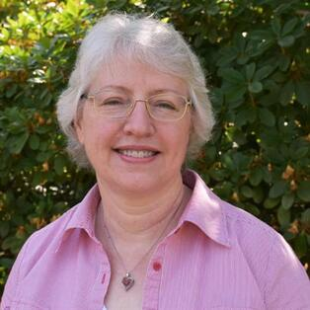
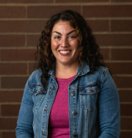
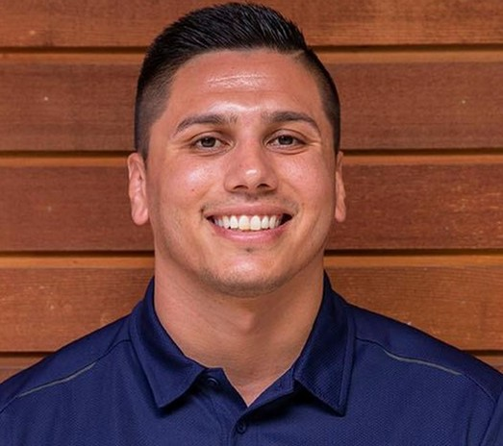
Meet the STEP Team
Joan Jagodnik,
STEP Grant
Coordinator Helen Paz
Benefits Navigator/STEP Coach
Maria Hermsen-Kritz,
Brett Sanchez, STEP Social Work Intern
Career Pathways/STEP Coach &
Head Wrestling Coach

Slide 9
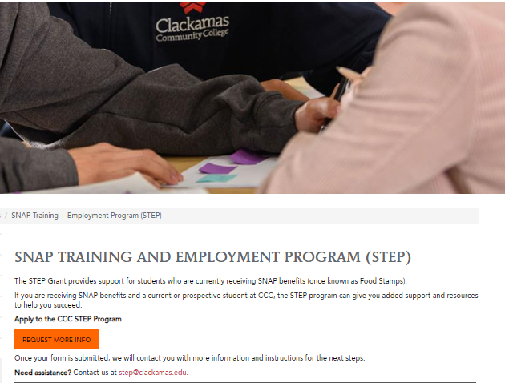
How to refer students to STEP
Refer students to our website
and have them submit a
“Request More Info” form:
www.Clackamas.edu/step
or
Email us at:
STEP@Clackamas.edu

Slide 10
Questions?

